Slide 1
Cluster analysis pt.1
(K-means)
A.Bakiu

Slide 2
What is clustering?
Is a form of unsupervised learning used to group similar observations together such in such a way that the observation in a cluster are more similar to one another than they are to observation in another cluster.
A form of exploratory data analysis (EDA) where observations are divided into meaningful groups that share common characteristics (features).
We aim to minimize the intracluster variance (within cluster variance) = WSS = «within sums of squares»

Slide 3
The flow of cluster analysis?
Pre-process the data
Select similarity measure
Cluster
Analyse

Slide 4
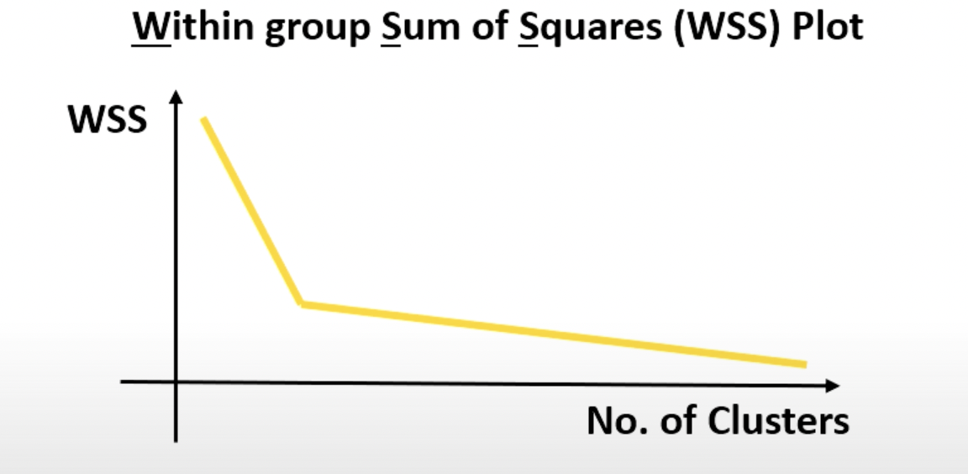
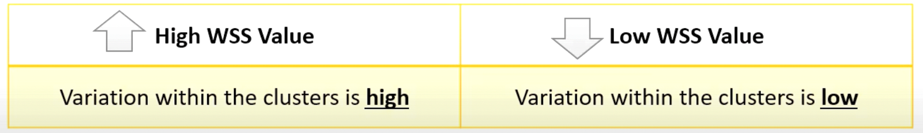
How to choose optimum number of clusters?

Slide 5
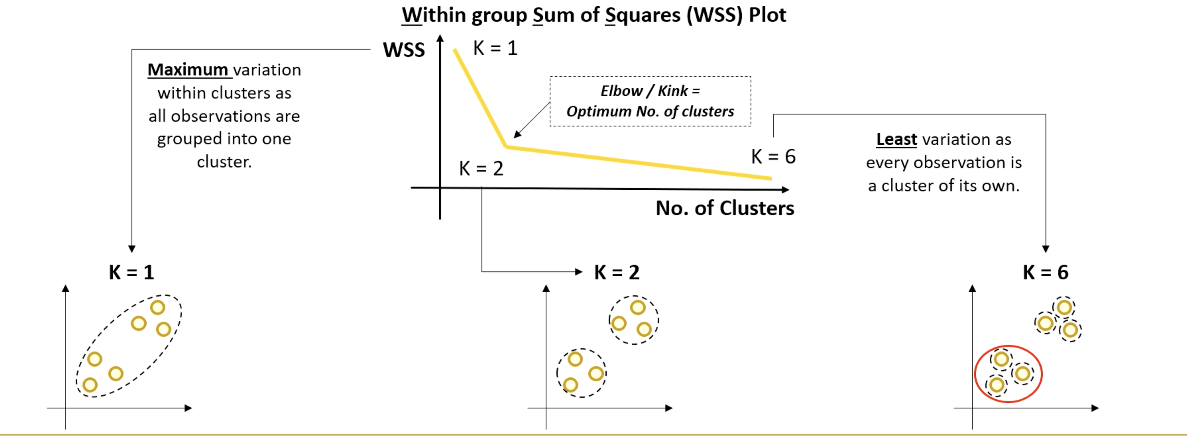
How to choose optimum number of clusters?
The least number
The optimal number of clusters
The biggest number

Slide 6
k-means
The k-means algorithm is an algorithm to cluster n objects, based on attributes into k partitions, where k<n.

Slide 7
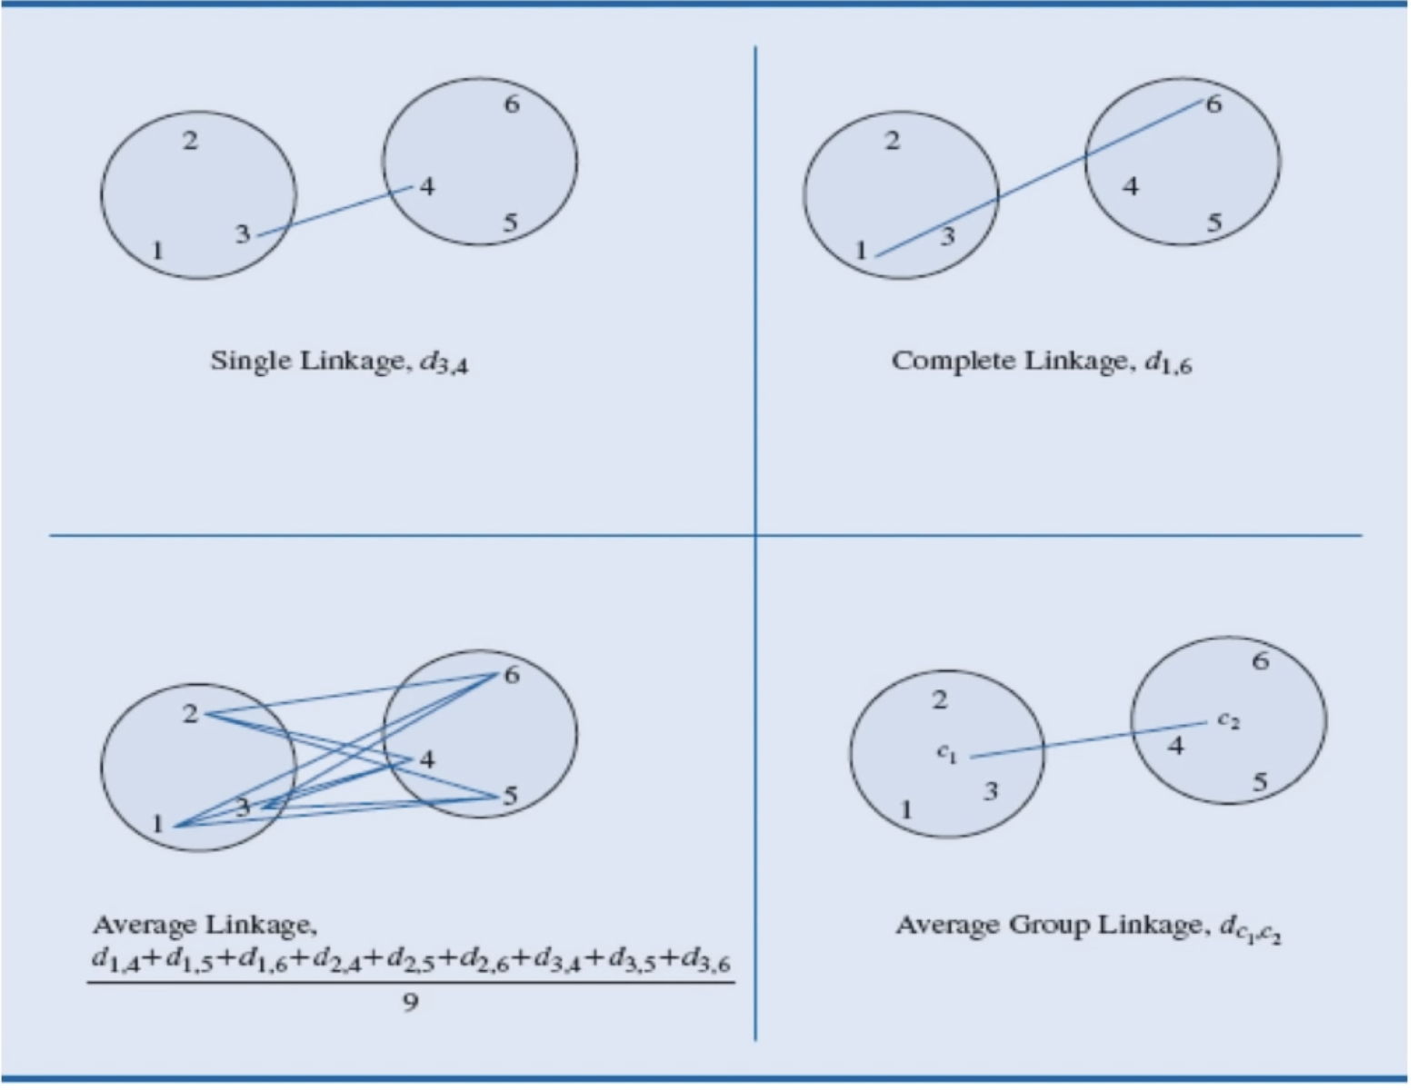
Measuring similarity between clusters
There are 4 types of measuring the distance between clusters:
Single linkage
Complete linkage
Average linkage
Average group linkage

Slide 8
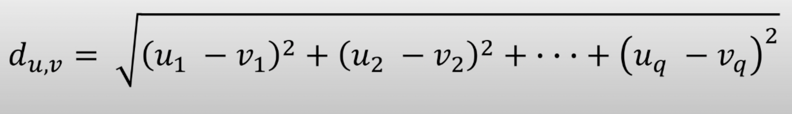
Measuring similarity between observations
Euclidean distance is the most common method to measure distance between observations, when observations include continuous variables.
Let observations u = (u1, u2, u3..., uq) and v = (v1, v2, v3..., vq) eacj comprise measurements of q variables.
The Euclidean distance between observations u and v is:

Slide 9
k-means algorithm
Step 1:
Randomly select k observations, called «cluster centroids».
Also known as centers, vector quantifieers (VQs), codework, or codebook vectors.
Step 2:
Compute the Eucledian distance from every observation to each of the k cluster centroid.

Slide 10
k-means algorithm
Step 3:
For each oth the n observations, assign the observation to its closest cluster.
Step 4:
Update the cluster centroid for each of the k clusters.
Compute the mean of all observations in that cluster (result in p-dimensional vector).
Step 5:
Cluster centroids no longer «move» or maximum of iteration reached

Slide 11
k-means clustering example
This example helps understand better the mechanisms of clustering with k-means methods.
Exercise: Cluster the following 8 points into 3 clusters: A1 (2,19) A2 (2,5) A3 (8,4) A4 (5,8) A5 (7,5) A6 (6,4) A7 (1,2) A8 (4,8)

Slide 12

k-means clustering example
Since k number is 3, let's decide 3 points randomly form the set of the point we have. Suppose that we have initial cluster centres as: A1(2,10) A4(5,8) A7(1,2)
The distance function between 2 points a=(x1,y1) and b(x2,y2) is defined as
Let's use k-mean algorithm to find 3 cluster centres after the second iteration:

Slide 13
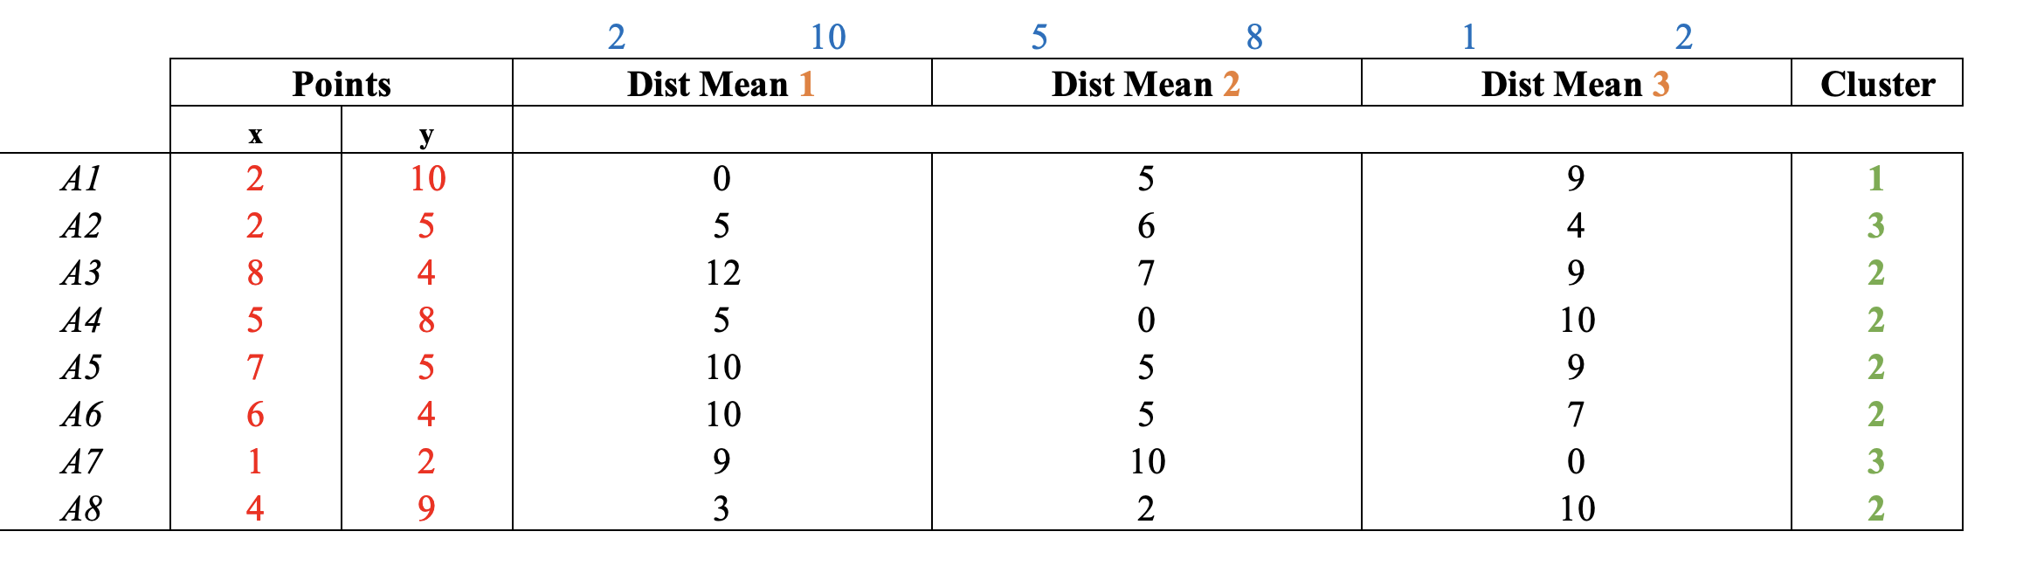
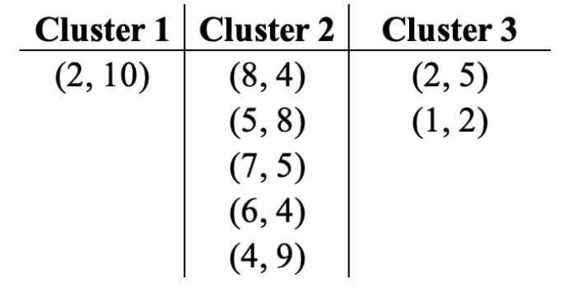
k-means clustering example

Slide 14
k-means clustering example
Repeating the same thing but this time updating the center of the clusters.
Center of each cluster is updated by calculating the centroids of each of these clusters, that is the average of al x and y.
Next we need to recompute the new clusters (mean) by taking the mean of all points in each cluster.
For Cluster 1, we only have A1(2,10) so remains the same.
For Cluster 2, the new center results (6,6)
For Cluster 3, the new center results (1,5; 3,5)

Slide 15
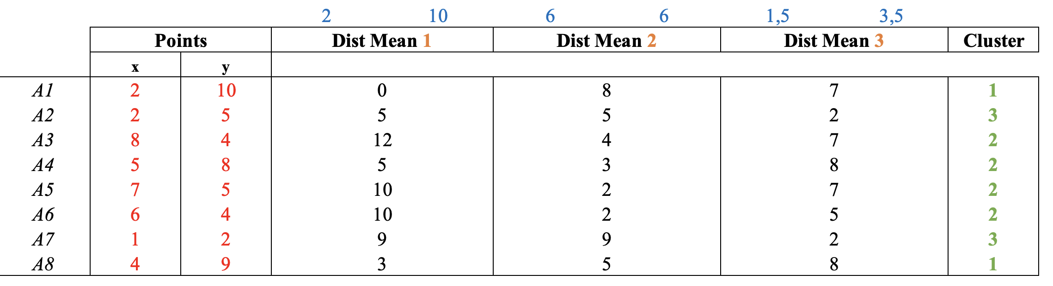
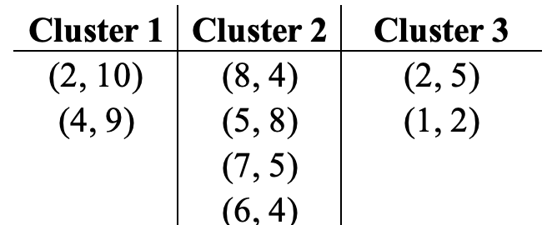
k-means clustering example

Slide 16
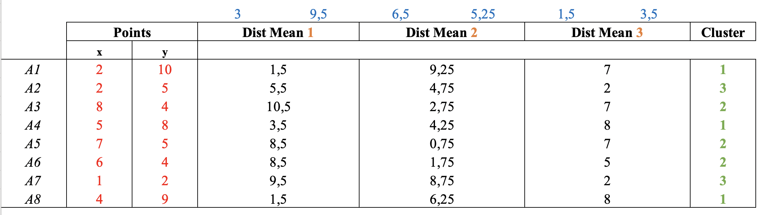
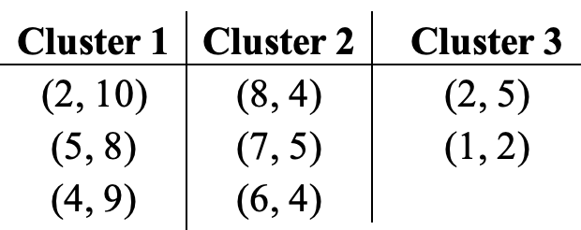
k-means clustering example
Recompute the cluster means again in the same way:

Slide 17
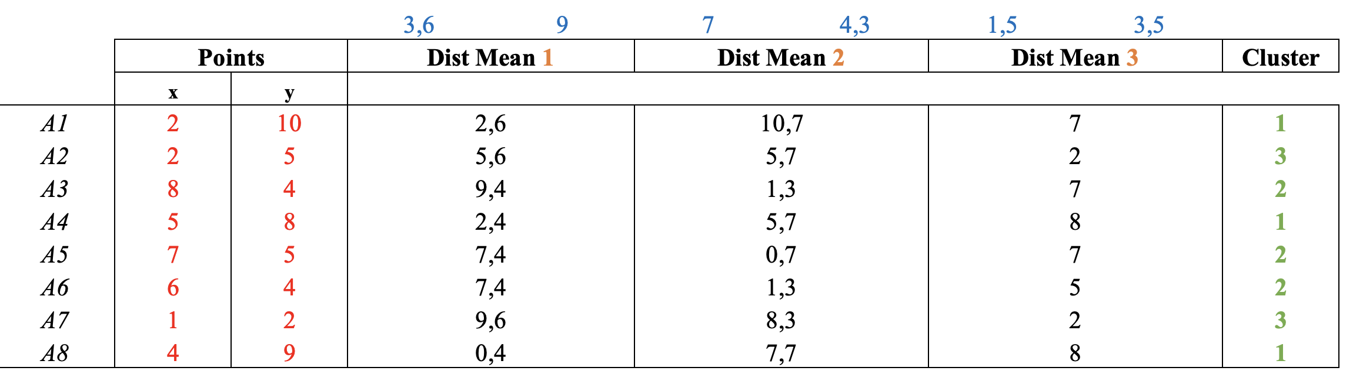
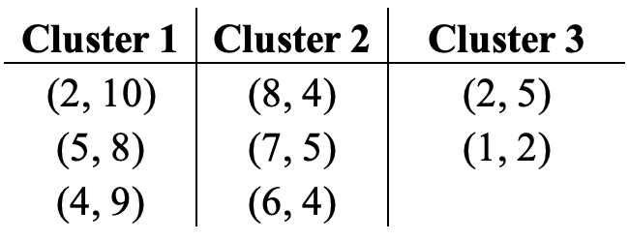
Recompute again and this time we do not see any changes, FINAL ALLOCATION.

Slide 18
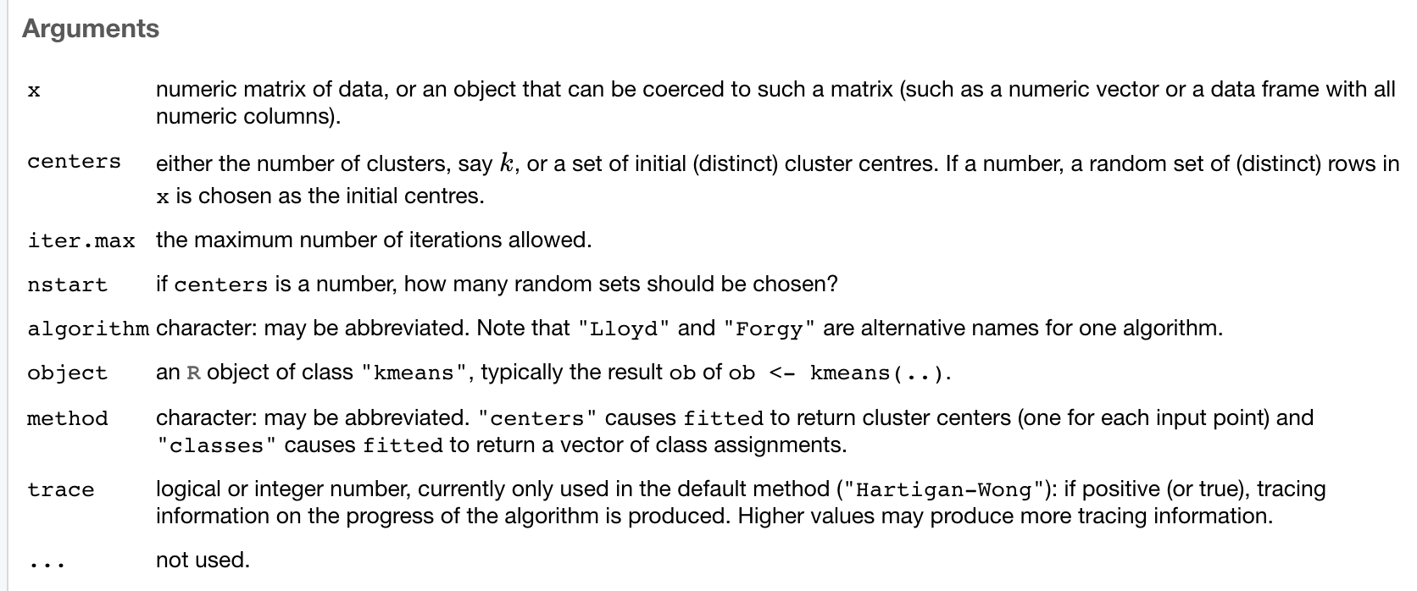
Arguments of the kmeans() function in R

Slide 19
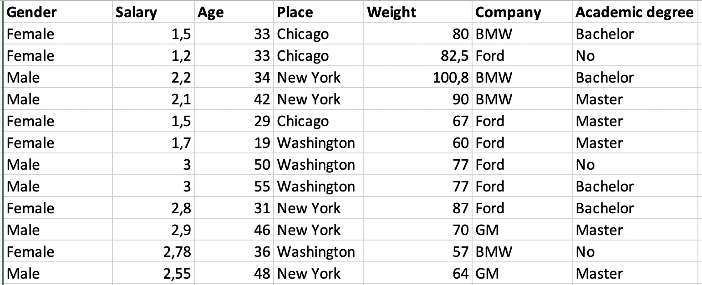
Syntax in R for k-means
Example using the dataset below.

Slide 20
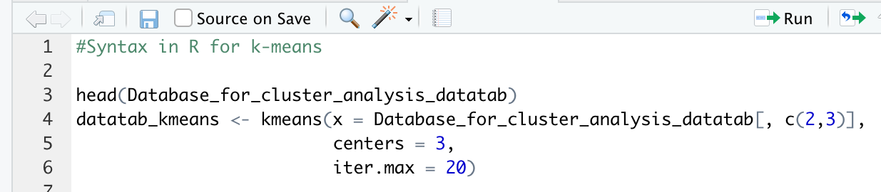
Syntax in R for k-means
1st, 4th, 6th and 7th columns are non-numerci so must be removed to perform clustering.
Centers represent value of k (clusters)
iter.max represent stopping criteria

Slide 21
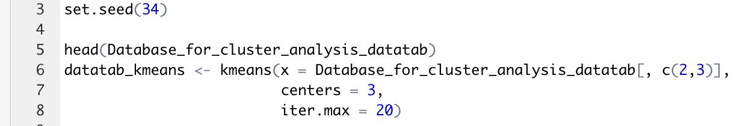
Reproducibility of k-means
You must set a seed before running k(means) if you want it to be reproducibile.

Slide 22


Output of kmeans() function in R
The «cluster» element gives the cluster labels for each of the n observation.
The «withinss» gives the WSS for each of the k clusters.
The «tot.withinss» gives the total WSS

Slide 23
How do we pick the value of k?
Find the k-value for which there is no longer a meaningful decrease in the total WSS.
If we pick the value of k that results the lowest total within SS, we might have far too many clusters. To prevent this we may use the Davies-Bouldin index, which penalizes overfitting and lower values are preferred.

Slide 24
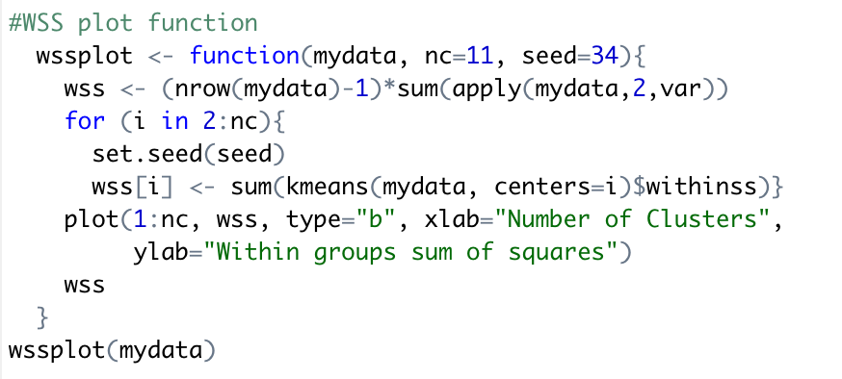
WSS function
We can not find WSS function by default in R, so we plot the function with this code:

Slide 25
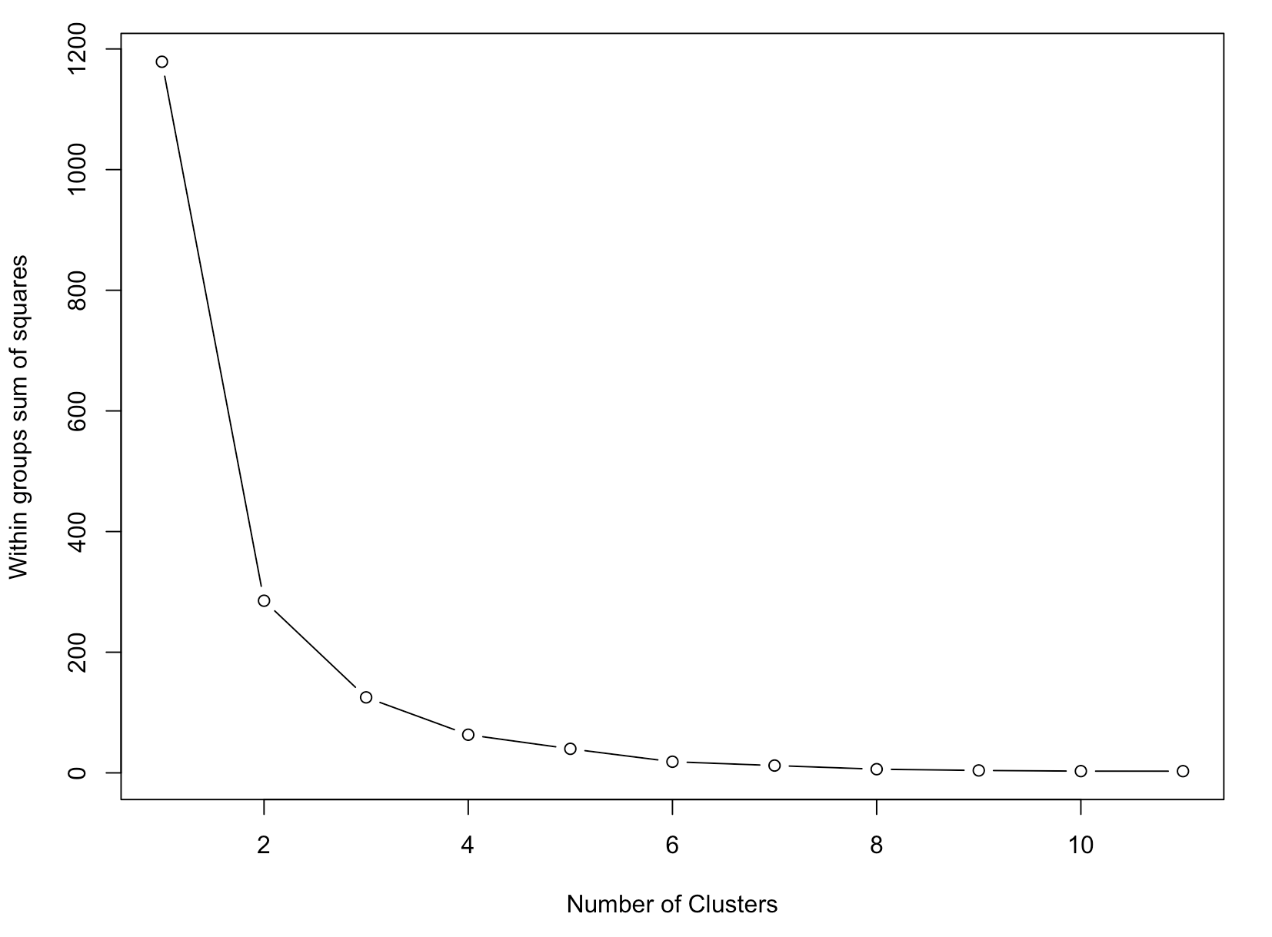
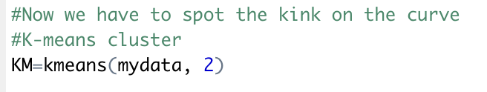
WSS function
Then we have to spot the «kink» on the curve. There IS the right number of cluster.
In this case is equal to 2.

Slide 26
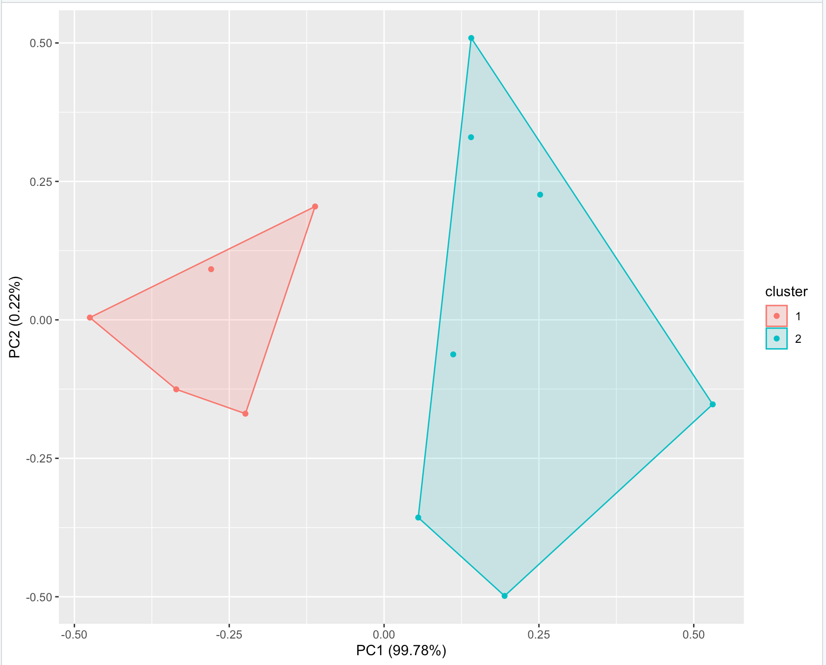
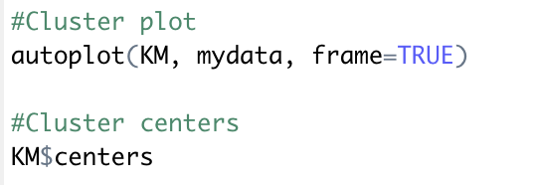
Evaluating cluster analysis

